Slide 1
BINARY TREES && TREE TRAVERSALS

Slide 2
DEFINITION : Binary Tree
root
A binary tree is made of nodes
Each node contains
a "left" pointer -- left child
a "right" pointer – right child
a data element.
The "root" pointer points to the topmost node in the tree. The left and right pointers recursively point to smaller
"subtrees" on either side. A null pointer represents a binary tree with no elements -- the empty tree.
left child
right child

Slide 3
DEFINITION : Binary Tree
a
The size of a binary tree is the number of nodes in it
This tree has size 9
The depth of a node is its distance from the root
a is at depth zero
e is at depth 2
The depth of a binary tree is the depth of its deepest node
This tree has depth 3
b
c
d
e
f
g
h
ı

Slide 4
DEFINITION : Binary Tree
a
The size of tree??
The depth of tree??
b
c
d
e
f
g
h
i
j
k
l

Slide 5
A Typical Binary Tree Declaration
struct node {
int data;
struct node * left;
struct node * right; };

Slide 6
Create a binary tree
EXAMPLE:
Get numbers from user till -1.
Insert a new node with the given number into the tree in the correct place
Rule : each right node will be greater than its root and each left node will be less than its root

Slide 7
Create a binary tree : EXAMPLE
typedef struct node * BTREE;
/* CREATE A NEW NODE */
BTREE new_node(int data)
{
BTREE p;
p=( BTREE)malloc(sizeof(struct node));
p->data=data;
p->left=NULL;
p->right=NULL;
return p;
}

Slide 8
Create a binary tree : EXAMPLE
typedef struct node * BTREE;
/* INSERT DATA TO TREE */
BTREE insert(BTREE root, int data)
{
if(root!=NULL)
{ if(data<root->data) root->left= insert(root->left,data);
else root->right=insert(root->right,data);
}
else {root=new_node(data);}
return root;
}

Slide 9
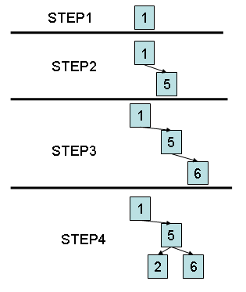
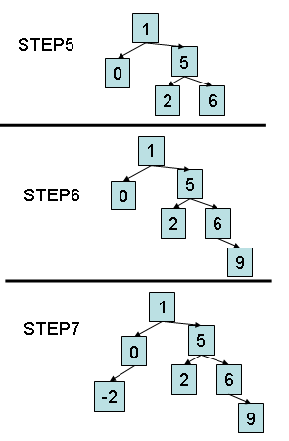
Create binary tree : Example
main()
{
BTREE myroot =NULL;
int i=0;
scanf(“%d”,&i);
while(i!=-1)
{
myroot=insert(myroot,i);
scanf(“%d”,&i);
}
}
// INPUT VALUES 1 5 6 2 0 9 -2

Slide 10
BINARY TREE TRAVERSALS 1/5
Several ways to visit nodes(elements) of a tree
Inorder 1. Left subtree 2. Root 3. Right subtree | Preorder 1. Root 2. Left subtree 3. Right subtree | Postorder 1. Left subtree 2. Right subtree 3. Root

Slide 11
BINARY TREE TRAVERSALS 2/5
void inorder(BTREE root)
{ if(root!=NULL)
{ inorder(root->left);
printf(“%d”,root->data); inorder(root->right); }
}
void preorder(BTREE root)
{
if(root!=NULL)
{ printf(“%d”,root->data);
preorder(root->left);
preorder(root->right); }
}
void postorder(BTREE root)
{ if(root!=NULL)
{ postorder(root->left);
postorder(root->right);
printf(“%d”,root->data); }
}

Slide 12
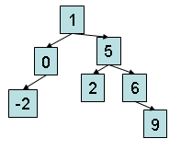
BINARY TREE TRAVERSALS 3/5
void inorder(BTREE root)
{ if(root!=NULL)
{ inorder(root->left);
printf(“%d”,root->data); inorder(root->right); }
}
// OUTPUT : -2 0 1 2 5 6 9

Slide 13
BINARY TREE TRAVERSALS 4/5
void preorder(BTREE root)
{
if(root!=NULL)
{ printf(“%d”,root->data);
preorder(root->left);
preorder(root->right); }
}
// OUTPUT : 1 0 -2 5 2 6 9

Slide 14
BINARY TREE TRAVERSALS 5/5
void postorder(BTREE root)
{ if(root!=NULL)
{ postorder(root->left);
postorder(root->right);
printf(“%d”,root->data); }
}
// OUTPUT : -2 0 2 9 6 5 1

Slide 15
FIND SIZE OF A TREE
int size ( BTREE root)
{
if(root!=NULL)
return(size(root->left) + 1 + size(root->right));
else return 0;
}

Slide 16
Max Depth of a tree
int maxDepth(BTREE node)
{ int lDepth; int rDepth;
if (node==NULL) return(0);
else
{ // compute the depth of each subtree
lDepth = maxDepth(node->left);
rDepth = maxDepth(node->right);
// use the larger one
if (lDepth > rDepth) return(lDepth+1);
else return(rDepth+1);
}
}

Slide 17
Delete a node from a tree (1/5)
BTREE delete_node(BTREE root,int x) // SEARCH AND DELETE x in tree
x> root->data → search right subtree
x<root->data → search left subtree
root->data==x
3.1 root is a leaf node → free root =free tree
3.2 root has no left subtree → root=root->right
3.3 root has no right subtree → root=root->left
3.4 root has right and left subtree ☹ → append right subtree to left subtree

Slide 18
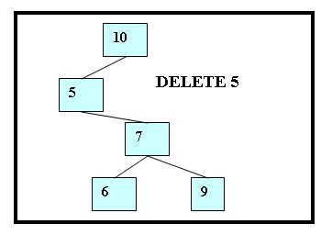
Delete a node from a tree (2/5)
BTREE delete_node(BTREE root,int x) // SEARCH AND DELETE x in tree
x> root->data → search right subtree
x<root->data → search left subtree
root->data==x
3.1 root is a leaf node
3.2 root has no left subtree → root=root->right
3.3 root has no right subtree
3.4 root has right and left subtree ☹
( 3.2nd Case)

Slide 19
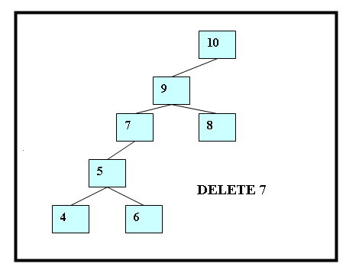
Delete a node from a tree (3/5)
BTREE delete_node(BTREE root,int x) // SEARCH AND DELETE x in tree
x> root->data → search right subtree
x<root->data → search left subtree
root->data==x
3.1 root is a leaf node
3.2 root has no left subtree
3.3 root has no right subtree → root=root->left
3.4 root has right and left subtree ☹
( 3. 3th Case)

Slide 20
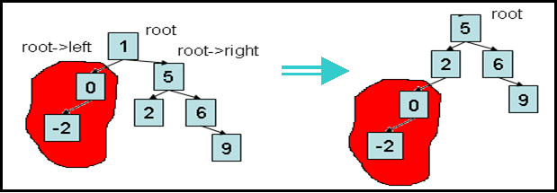
Delete a node from a tree (4/5)
BTREE delete_node(BTREE root,int x) // SEARCH AND DELETE x in tree
x> root->data → search right subtree
x<root->data → search left subtree
root->data==x
3.1 root is a leaf node
3.2 root has no left subtree
3.3 root has no right subtree
3.4 root has right and left subtree ☹ → append right subtree to left subtree
( 3.4th Case)

Slide 21
Delete a node from a tree (5/5)
BTREE delete_node(BTREE root,int x)
{ BTREE p,q;
if(root==NULL) return NULL; // no tree
if(root->data==x) // find x in root
{ if(root->left==root->right) // root is a leaf node
{ free(root); return NULL; }
else {
if(root->left==NULL) { p=root->right; free(root); return p; }
else if(root->right==NULL) { p=root->left; free(root); return p; }
else { p=q=root->right;
while(p->left!=NULL) p=p->left;
p->left=root->left;
free(root);
return q; }
}
}
if(root->data<x) { root->right=delete_node(root->right,x); }
else { root->left=delete_node(root->left,x); }
return root;
}

Slide 22
Search a node in a tree
Search in binary trees requires O(log n) time in the average case, but needs O(n) time in the worst-case, when the unbalanced tree resembles a linked list
PSEUDOCODE
search_binary_tree(node, key)
{ if ( node is NULL) return None // key not found
if (key < node->key)
return search_binary_tree(node->left, key)
elseif (key > node->key)
return search_binary_tree(node->right, key)
else return node // found key
}

